Slide 1
KINDNS: Promoting DNS Security Operational Best Practices
CAPIF 3
September 2024
Mikhail Anisimov
ICANN

Slide 2

Knowledge-sharing and
Instantiating
Norms for
DNS (Domain Name System) and
Naming
Security
….. is pronounced ”kindness.”

Slide 3
KINDNS – Promoting DNS Operational Best Practices
An initiative to produce something simple that can help a wide variety of DNS operators, from small to large, to follow both the evolution of the DNS protocol and the best practices the industry identifies for better security and more effective DNS operations.
Notes:
The effects of private networks

Slide 4
Targeted Operators
TLDs & Critical Zones
SLDs
Authoritative Operators
Closed & Private
Shared Private
Public
Resolver Operators
Hardening the Core System
By joining the KINDNS initiative, DNS Operators are voluntarily committing to adhere to the identified practices and act as “goodwill ambassadors” within the community.

Slide 5
Authoritative DNS Operators of Critical Zones
1. MUST be DNSSEC signed and follow key management best practices
2. Transfer between authoritative servers MUST be limited
3. Zone file integrity MUST be controlled
4. Authoritative and recursive nameservers MUST run on separate infrastructure
TLDs & Critical Zones
5. A minimum of two distinct nameservers MUST be used for any given zone
6. There MUST be diversity in the authoritative DNS software packages
7. Authoritative servers for a given zone MUST run from a diversified infrastructure
8. The infrastructure that makes up your DNS infrastructure MUST be monitored

Slide 6
Authoritative DNS Operators of SLDs
1. MUST be DNSSEC signed and follow key management best practices
2. Transfer between authoritative servers MUST be limited
3. Zone file integrity MUST be controlled
SLDs
4. Authoritative and recursive nameservers MUST run on separate infrastructure
5. A minimum of two distinct nameservers MUST be used for any given zone
6. Authoritative servers for a given zone MUST run from a diversified infrastructure
7. The infrastructure that make up your DNS infrastructure MUST be monitored

Slide 7
Closed & Private Resolver Operators
Private resolvers are not publicly accessible and cannot be reached over the open internet. They are typically found in corporate networks or other restricted-access networks
1. DNSSEC validation MUST be enabled
2. ACL statements MUST be used to restrict who may send recursive queries
3. QNAME minimization MUST be enabled
Closed & Private Resolvers
4. Authoritative and recursive nameservers MUST run on separate infrastructure
5. At least two distinct servers MUST be used for providing recursion services
6. Recursive servers MUST run from a diversified Infrastructure
7. The infrastructure that makes up your DNS infrastructure MUST be monitored

Slide 8
Shared Private Resolver Operators
Shared private resolver operators are typically ISPs or similar hosting service providers. They offer DNS resolution services to their customers (mobile, cable/DSL/fiber users, as well as hosted servers and applications).
1. DNSSEC validation MUST be enabled
2. ACL statements MUST be used to restrict who may send recursive queries
3. QNAME minimization MUST be enabled
4. Authoritative and recursive nameservers MUST run on separate infrastructure
Shared Private Resolvers
5. At least two distinct servers MUST be used for providing recursion services
6. The infrastructure that make up your DNS infrastructure MUST be monitored
7. For privacy consideration: encryption (DoH or DoT) SHOULD be enabled
8. Private resolver operators SHOULD have software diversity

Slide 9
Public Resolver Operators
This category includes both open and closed public resolvers. Closed public resolvers are typically commercial DNS filtering/scrubbing services, such as DNSFilter and OpenDNS.
1. DNSSEC validation MUST be enabled
2. QNAME minimization MUST be enabled
3. For privacy consideration: Encryption (DoH or DoT) SHOULD be enabled
4. Authoritative and recursive nameservers MUST run on separate infrastructure
Public Resolvers
5. Data collected through passive logging of DNS queries MUST be limited
6. At least two distinct servers MUST be used for providing recursion services
7. Private resolver operators SHOULD have software diversity
8. The infrastructure that makes up your DNS infrastructure MUST be monitored

Slide 10
Hardening the Core
In addition to implementing best practices for DNS security and for DNS availability and resilience, all operators must pay careful attention to practices for hardening the platforms their DNS services use.
1. ACLs MUST be implemented to control network traffic to your DNS servers
2. BCP38/MANRS egress filtering MUST be implemented
3. The configuration of each DNS server MUST be locked down
4. User permissions and application access to system resources MUST be limited
Core Hardening
5. System and service configuration files MUST be versioned
6. Access to management services MUST be restricted
7. Access to the system console MUST be secured using cryptographic keys and/or a multi-factor authentication mechanism
8. Credentials for customer access MUST offer two-factor authentication

Slide 11
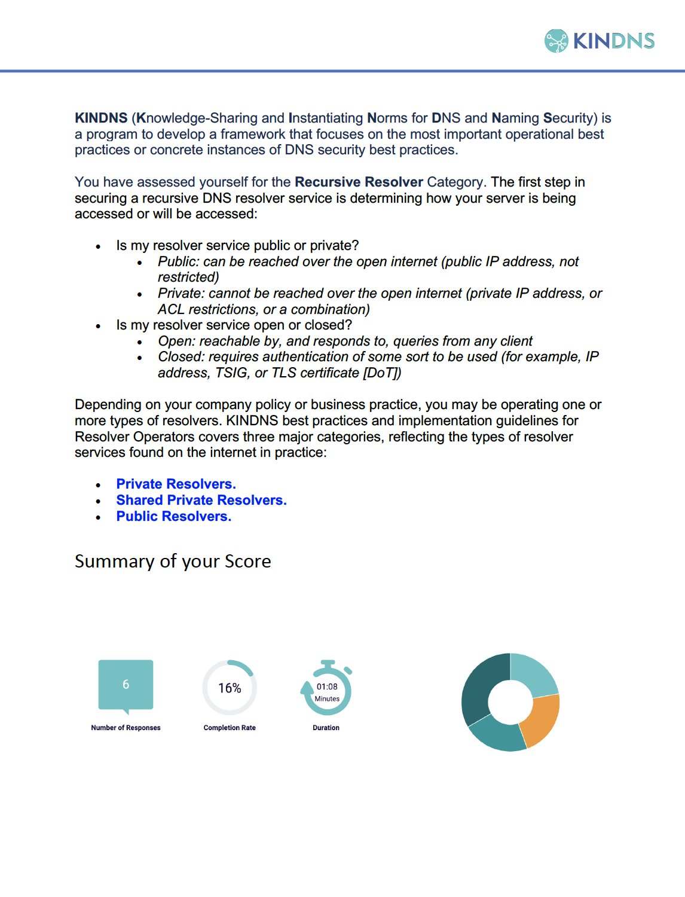

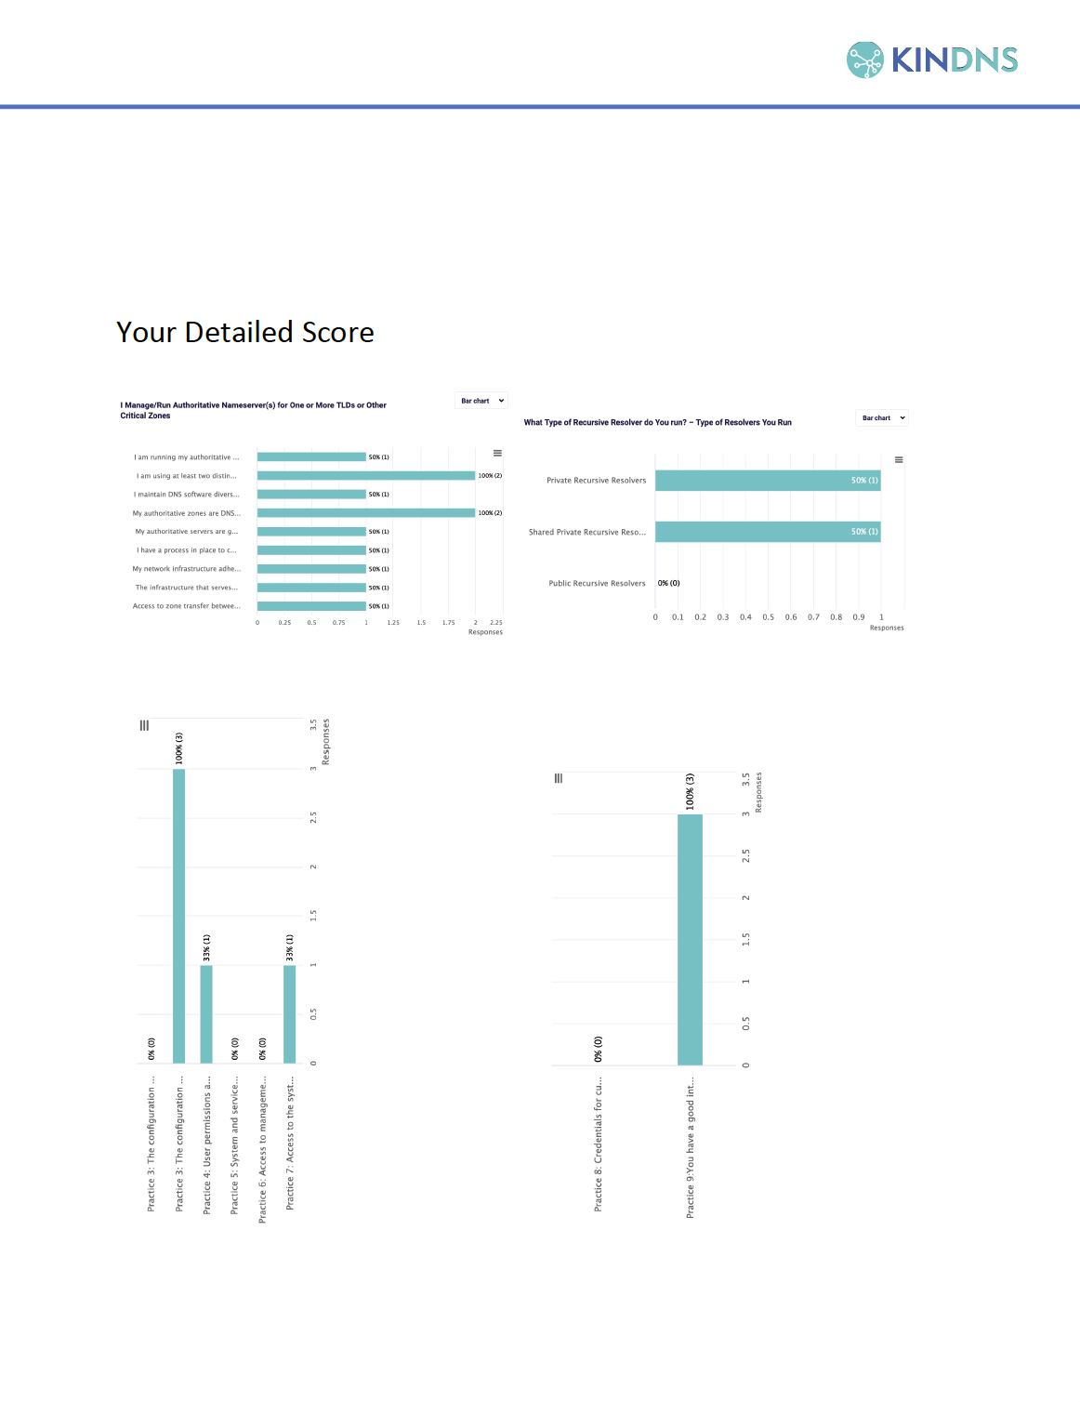
Self-Assessment & Reports
Operators in each category can self-assess their operational practices against KINDNS and use the report to correct/adjust unaligned practices
  Self-Assessments will be anonymous, and a report can be directly downloaded from the web site
Operators can enroll to participate in one or many categories covered by KINDNS
  Participation in KINDNS mean voluntarily committing to implement and adhere to agreed norms and practices
  Participants becomes goodwill ambassadors and promote practices

Slide 12
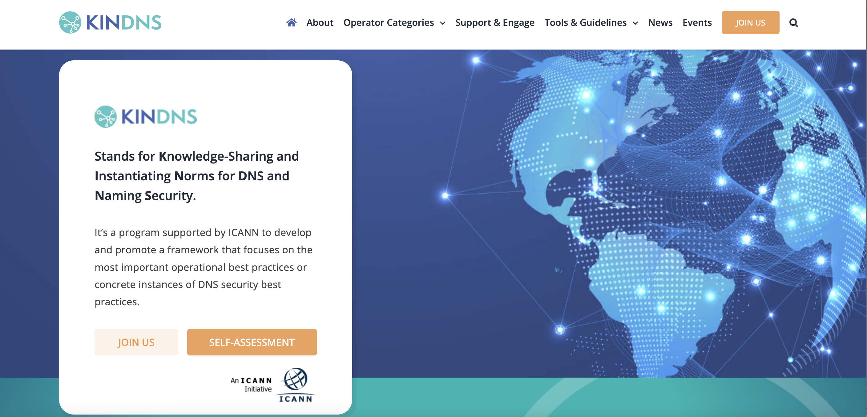
How to Stay Informed and Contribute
https://www.kindns.org
The KINDNS discussion mailing list: kindns-discuss@icann.org

Slide 13
Engage with ICANN – Thank You and Questions
Email: champika.wijayatunga@icann.org

